Slide 1


Process and
Job Control in Linux
Ben C. Roose
    Electrical Engineering & Computer Science
    Systems Administrator, Wichita State University
Maintain Debian, Ubuntu, and Linux Terminal Server Project Labs
Notes:
Linux Deep Dive...building towards the next talk given by Alex Juarez on /proc
Introduce tutorial (theory), me, and WSU!
Before we get started, CLICK

Slide 2

Kansas Linux Fest 2017
Sat & Sun, May 13 & 14, 2017
Wichita State University, Wichita, KS
kansaslinuxfest.org
Notes:
Briefly plug Kansas Linux Fest 2017!
Okay, on with the show! CLICK

Slide 3

What are we talking about?
We will look at:
Processes (PID) and the ps command
Parent and child processes (PPID)
Terminals, pseudoterminals, and shells
Process sessions (SID) and process groups (PGID)
Orphan and zombie processes
Signals, terminal keybindings, and the kill command
Process job control
Notes:
Quick run down of what we will talk about over the next 40 minutes!

Slide 4
Linux Processes
What is a process in Linux?
According to The Linux Information Project (www.linfo.org):
  “A process is an executing (i.e. running) instance of a program.”
  “A program is a passive entity until it is launched, and a process can be thought of as a program in action.”
A process is identified in a system by a unique PID number
(a non-negative integer).
The system kernel maintains a list of active process PIDs
Notes:
ASK: WHAT IS A PROCESS?
CLICK:
According to The Linux Information Project....
They also state:
“Processes are dynamic entities in that they are constantly changing as their machine code instructions are executed by the CPU.”
CLICK:
Each process on a system can be identified by a Process Identification number (PID), using non-negative integer
ASK: WHAT IS A NON-NEGATIVE INTEGER?
The kernel will hold a list of active processes
WHAT IS THE KERNEL?
END: So how is a process run (executed)?

Slide 5
Parents and Children
Process can be executed by spawning/forking from another process.
Spawning creates child process(es) from a parent.
Every process has a parent and hence has a PPID number.
Processes can terminate by:
  Exiting without error
  Exiting upon error
  System (kernel) forcing the process to terminate
Notes:
Program execution is a forking of a new process by another (running) process. This creates a child from a parent.
So each process has a Parent Process ID (PPID).
That's process execution, how about process termination?
CLICK
Talk about process termination (ending of a process)
END: Lastly we need to know how to interact with a process, for that we need a terminal!

Slide 6

Terminals and Pseudoterminals
According to The Linux Information Project, the terminal (also known as a virtual console) is:
  “a display mode that contains only text and no images and that occupies the entire screen of the display device (usually a CRT or LCD).”
The terminal is an input/output character device often listed as:
/dev/tty#
A Pseudoterminal is a window within the GUI which “emulates” a terminal character device by using process file streams.
The pseudoterminal is often listed as device:
/dev/pts or /dev/ptmx
So how do we interact with programs using a terminal or pseudoterminal?
AN/UGC-74A Teletypewriter
Notes:
Let's shift into Terminals
CLICK:
According to Linux Information Project a terminal has 4 definitions but the most recent....
The terminal is a character device and often symonymous with the command-line interface!
ASK: WHAT IS A CHARACTER DEVICE?
SIDE-QUESTION: DOES ANYONE KNOW WHY WE CALL IT A TTY?
CLICK:
ANSWER: tty = teletypewriter is a now obsolete electromechanical typewriter that was widely used to communicate typed messages from point to point through a simple electrical communications channel
CLICK:
Talk about pseudoterminals as GUI windows!
It is a process which uses file streams for input and output (FOR THOSE PROGRAMMERS IN AUDIENCE: STDIN, STDOUT, STDERR)
CLICK:
ASK: HOW DO WE USE THE TERMINAL?

Slide 7
The Shell
The shell is a program and runs as a process:
  Connected to a controlling terminal (or pseudoterminal)
  Acts as interface between the user and the operating system
  Spawns (executes) other processes via commands
  Contains additional functionality: file stream redirection, command history, keyboard shortcuts, and process control
What are some common shell programs?
  Borne Again Shell (bash) – default shell in Linux
  Borne Shell (sh)
  Korn Shell (ksh)
  C Shell (csh)
  TENEX C Shell (tcsh)
Notes:
Explain a shell is a process (not the terminal itself, but it read and writes to the terminal (or pseudoterminal) when the shell process is in the foreground.
CLICK:
ASK: WHAT ARE SOME COMMON SHELLS?
CLICK: YES!
So Let's look at a shell process

Slide 8

Example: The Shell as a Process
A child process is given a unique process number (PID)
A child process inherits from its parent:
  Parent Process number (PPID)
A child process inherits from its parent (or sets its own):
  Process Group Identification number (PGID)
  Session Identification number (SID)
Notes:
The command ps (like top or htop) displays process information by probing/reading the /proc directory (pseudo-filesystem).
ASK: WHAT IS THE /PROC DIRECTORY?
MENTION? pgrep uses grep to find a process in ps
Breakdown ps command
-o = option to display custom output for ps
$$ = PID of the current process (i.e. the bash shell) an environment variable!
CLICK:
Review on example bash process, TTY, PID, PPID
ASK: SO WHAT IS PGID AND SID?
CLICK:
PGID is the Process Group Identification number.
SID is the Session Identification number.
Each child process (spawned) inherits its process group ID and session ID from its parents.
NOTICE how the shell's PGID and SID are the same as its own PID!

Slide 9
Sessions and Groups
Process Session (SID)
  A process is a member of a session
  Specific processes, such as the shell, can become session leaders
  (where SID = PID)
  A session may have a maximum of one controlling terminal
Process Group (PGID)
  A group is a collection of one or more processes
  Shell will execute a command with the first process in the command as group leader (where PGID = PID)
  Within a session, only one process group can be in the foreground at any time and have access to the terminal
  All other process groups in a session are in the background
Notes:
Process Session
For example a shell can become a session leader and then open a controlling terminal (tty)
A session may have only one (or no) controlling terminal
CLICK:
Process Group
When a new command line is executed/run in the shell, the first process (command) is made the group leader.
At any time, only one process group in a session can be in the FOREGROUND and have direct read/write access to the controlling terminal.
All other process groups are running in the background.
When a command is run, the shell process will become a background group and hand over access to the controlling terminal to the newly run process group (i.e. in the foreground).
When the foreground process group terminates, the shell will automatically move itself into the foreground and take back access to the controlling terminal.

Slide 10
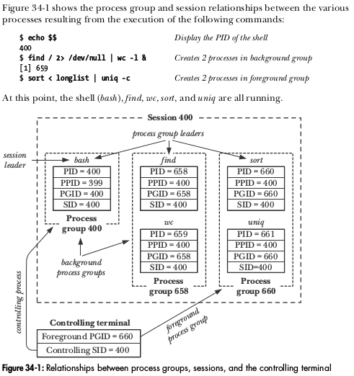
Example: Process Relationships
From: Kerrisk, M. (2010). The Linux Programming Interface (pp. 701)
Notes:
Walk through Kerrisk's example
Review: foreground and background relates to the process group, not a specific process!

Slide 11

Orphans and Zombies
What is an orphaned process?
First process run on a system is /sbin/init with PID = 1
Any orphaned process in which its parent process has terminated will be “adopted” by the init process (and gain a PPID of 1).
Notes:
To End this section, let's talk about orphans and zombie!
CLICK:
ASK: WHAT IS AN ORPHANED PROCESS?
A child process whose parent has terminated
CLICK:
The first process is the init process!
An orphaned process is adopted by the init process (and inherits its PID as a PPID)
CLICK:

Slide 12

Orphans and Zombies
What is a zombie process?
Parent process performs a wait() system call to see if child terminated
Until wait() is called, kernel holds PID of child in active process list
System shows that PID is active, but cannot be killed by any signal!
Notes:
CLICK:
ASK: WHAT IS A ZOMBIE PROCESS?
CLICK:
Parent process must make a wait() system call to see if (and how) a child process terminated.
If it doesn't make the wait() call then kernel still has the process PID as active and running in its list (and shows it in ps and top). However, no signal (including the sure SIGKILL will terminate.
Once the parent process terminates, then child “zombie” PID is adopted by init and init will automatically make a wait() system call on that child (thus removing it from the active list)!

Slide 13
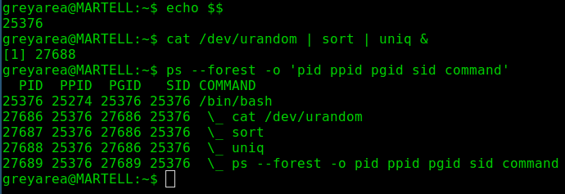
Example: Process Relationships
Notes:
I like green on black, reminds me of childhood with dad's Amstrad word processor in '80s!
Build a diagram something similar to Kerrisk pp. 701 fig. 34-1
Need to mention that & = places command as a background process group (otherwise command will become the foreground process group)
END: To understand more about process control, we need to look into software signals!

Slide 14

Signals
Notes:
We mentioned signals being sent.
SO WHAT ARE SIGNALS?
Talk about a software signal being similar to a hardware interrupt!
ASK: WHAT ARE SOME HARDWARE INTERRUPTS? (keyboard, serial port, hard drive, clock, watchdog timer)

Slide 15
Signals
A software signal is a notification to process or process group
  Similar to hardware interrupts
  Denoted by a unique number and a symbolic name
Software signals are sent by the system (kernel):
  to a specific process
  to the foreground process group within a session
  to one or more background process groups within a session
Notes:
Singals are idetified by a unique non-negative integer and by a symbolic name
CLICK:
Though processes can send signals to each other (one form of inter-process communication) ,we are interested in the signals sent by the kernel to process groups.
Remember: there can be only one foreground process group in any specific session (and only one controlling terminal connected to that session).

Slide 16
Sending and Receiving Signals
Signals are sent by the system:
  using specific processes, i.e. kill command
  using terminal keybindings, i.e. CTRL+C
When a signal is received by a process, it can:
  default to a standard behaviour: terminate, stop, or continue
  ignore the signal (not all signals can be ignored)
  run custom signal handler code, i.e. ping command
Notes:
Talk about a software signal is sent by processes (KILL) or terminal keybindings (keyboard shortcuts) (CTRL+C = SIGINT
CLICK:
Upon receiving a signal, a process can:
1. run as default behaviour (TALK about terminate, stop, and continue)
2. Ignore the signal (but some signals such as SIGKILL, SIGSTOP, can't be ignored)
3. Run custom signal handler code, such as the ping command when it receives SIGINT, it displays a summary of ping data before terminating

Slide 17
Common Signals
Sig Name | Sig # | Signal Description | Default Process Behaviour | Keybinding or command
SIGHUP | 1 | Terminal hangup | Process terminate | CTRL + D (EOL)
SIGINT | 2 | Terminal interrupt | Process terminate | CTRL + C
SIGQUIT | 3 | Terminal quit | Process core dump | CTRL + \
SIGTSTP | 20 | Terminal stop | Process stop | CTRL + Z
SIGTTIN | 21 | Term read from BG | Process stop | (sent by terminal)
SIGTTOU | 22 | Term write from BG | Process stop | (sent by terminal)
SIGTERM | 15 | Terminate process | Process terminate | kill <pid>
SIGKILL | 9 | Sure kill | Process terminate | kill -KILL <pid>
SIGSTOP | 19 | Sure stop | Process stop | kill -STOP -<pgid>
SIGCONT | 18 | Continue if stopped | Process continue | fg / bg / kill -CONT
Notes:
Walk through the common signals
Talk through the signals sent via a terminal
NOTE: EOL (end of line) sent when user types exit, CTRL+D or signal sent when terminal hangsup another way (i.e. SSH remote connection disconnects)
Signals such as SIGHUP or SIGINT are passed down from a parent process to its children (so all processes in a session or process group will terminate)
NOTE: Process stop means pause the process (but don't terminate it)
MENTION: core dump (used for debugging programs)
Talk through what happens when a process in a backgroup process group attempts to read from or write to the terminal (but mention that by default a shell will allow a process in the background to write to the terminal via the shell, i.e. display output from the process)
Talk through SIGCONT
Talk through process terminate and sure kill/stop using the kill command! (should try to use SIGTERM first, default in kill)!
MENTION: pkill uses grep to find a process and kill it

Slide 18
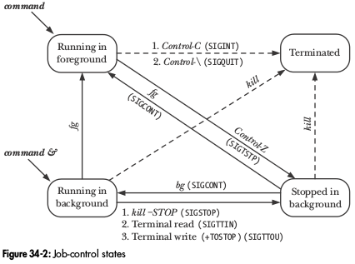
Putting it together to control processes
From: Kerrisk, M. (2010). The Linux Programming Interface (pp. 717)
Notes:
Talk through the control states of a process group
Move from running a command in foreground to stopped to running in background to terminate
Talk about using keybindings and fg / bg to shift between states
NOTICE: we can also use the ampasand to start a process in the background
Talk about the kill command sending different signals, including terminate, sure kill, sure stop, and continue
MENTION: with kill if you use a dash before the pid number, then it will send signal to entire process group (pgid)!
REMEMBER: we are controlling process groups, not single processes

Slide 19
Example on the Terminal: Job Control
Live Demonstration
by Ben if time allows!
Notes:
MAKE SURE YOU have job_mon in home directory
Talk about the process and group IDs as we walk through demo!
Ben list the commands here:
echo $$
./job_mon | ./job_mon &
./job_mon | ./job_mon | ./job_mon &
fg
TYPE CTRL+C (SIGINT)
TYPE CTRL+Z (SIGTSTP)
jobs (NOTE: talk about job numbers vs. PIDs)
bg
jobs
kill %1 %2

Slide 20
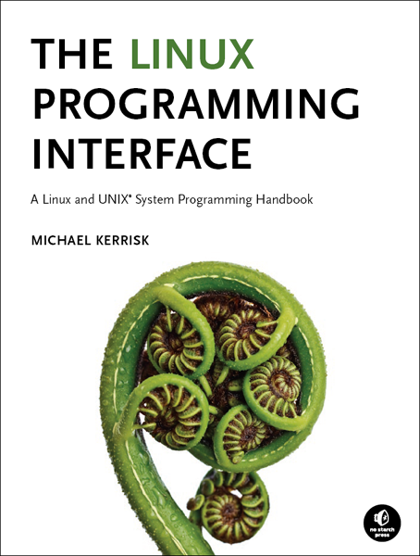
Kerrisk, Michael. (2010). The Linux Programming Interface. No Starch Press
Credit and plug...
A must read for Linux systems administrators, programmers, and enthusiasts looking for an in-depth discussion on the internal workings of UNIX.
For 30% sale discount and free ebook with the printed edition,
go to:
http://man7.org/tlpi/
Notes:
Shameless plug, but I get no money from this. I just think this is a great textbook for Linux gurus!
Michael Kerrisk wrote many of the man and info pages that we all take for granted

Slide 21

Thank You!
Ben Roose: ben.roose@wichita.edu
Any Questions?

Slide 22



Please attribute
Ben Roose, EECS, Wichita State University
This work is licensed under the Creative Commons
Attribution-ShareAlike 4.0 International License.
To view a copy of this license, visit http://creativecommons.org/licenses/by-sa/4.0/.

